Slide 1
PLC Controls Lab
Team 519
Grant Hoffmeyer & Jack Vranicar
Virtual Design Review #5, February 18, 2025

Slide 2
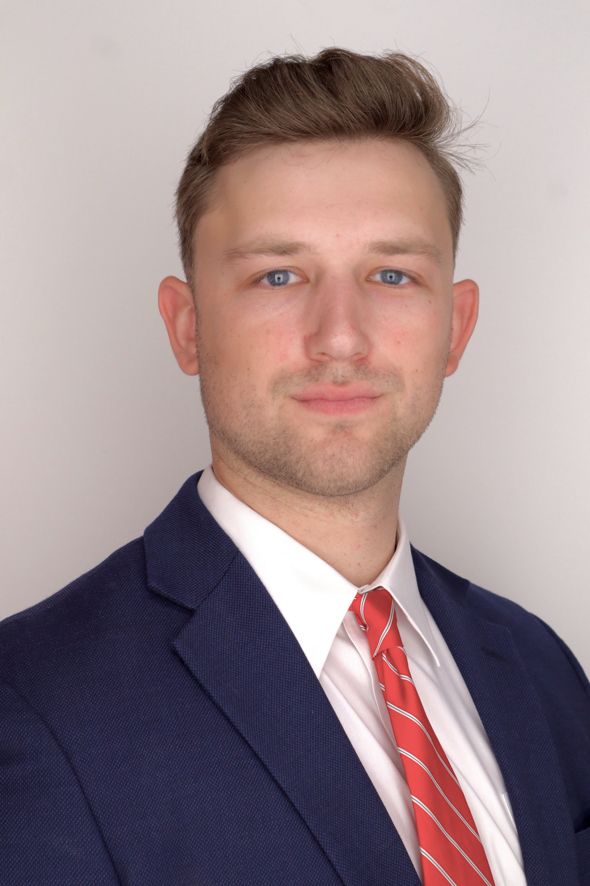
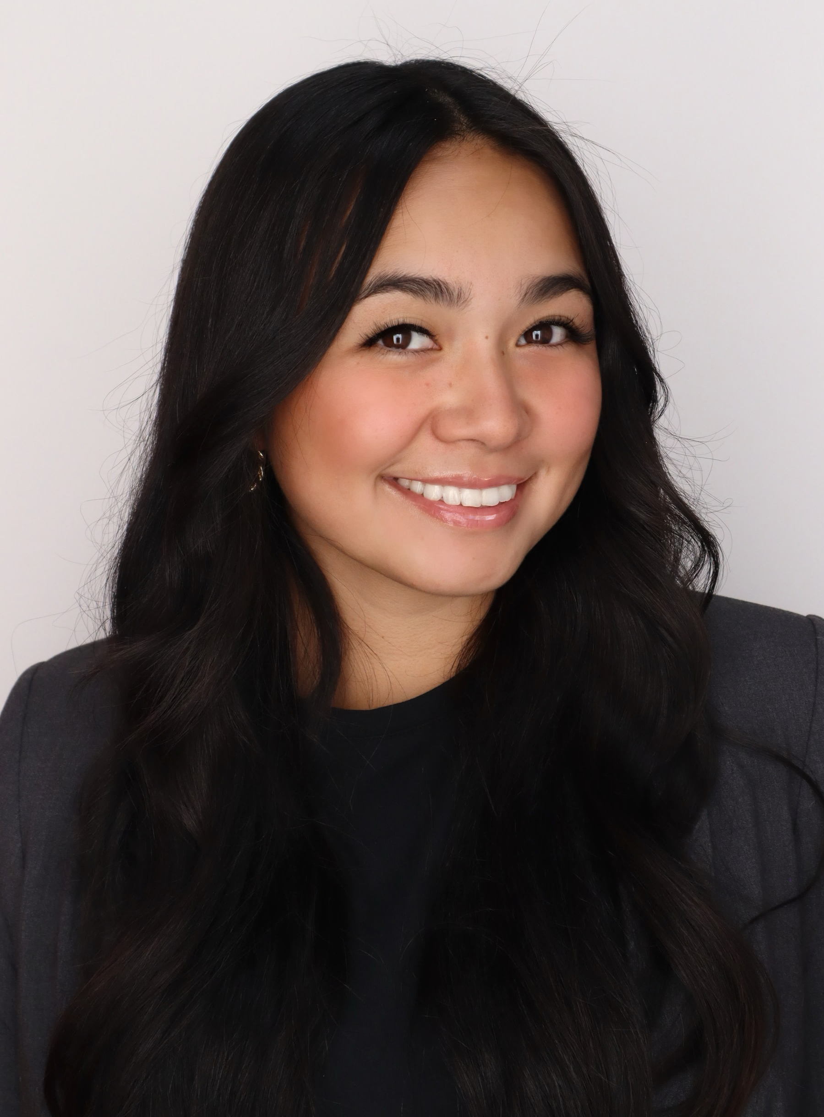
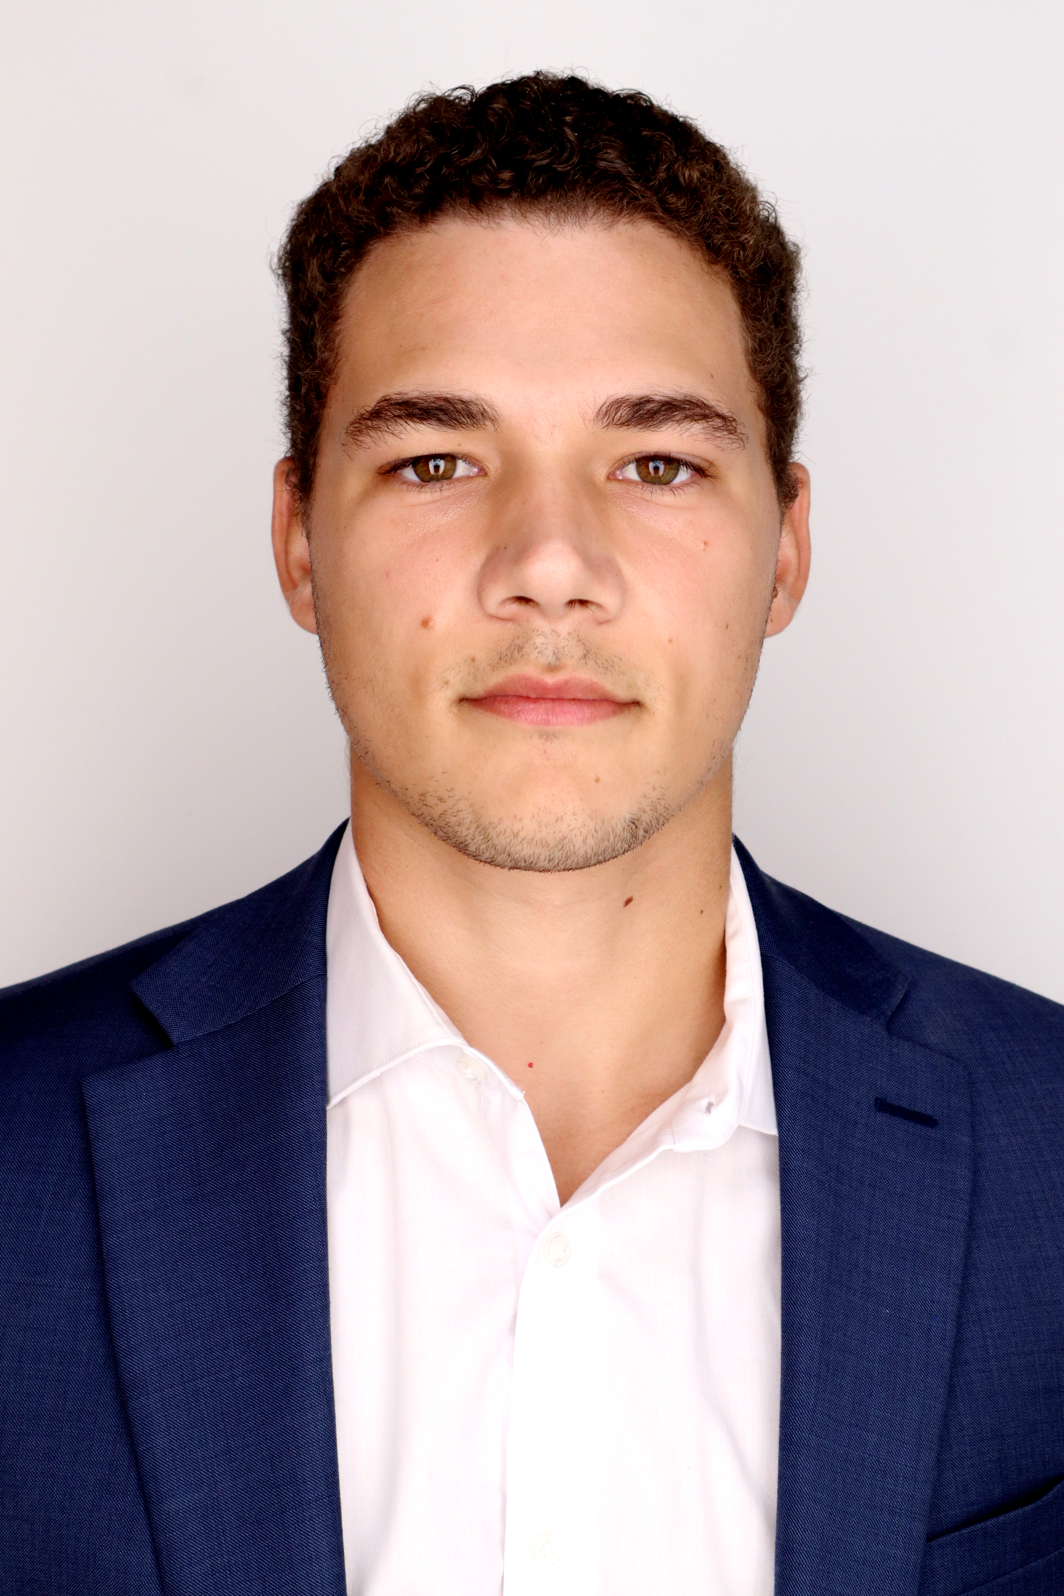
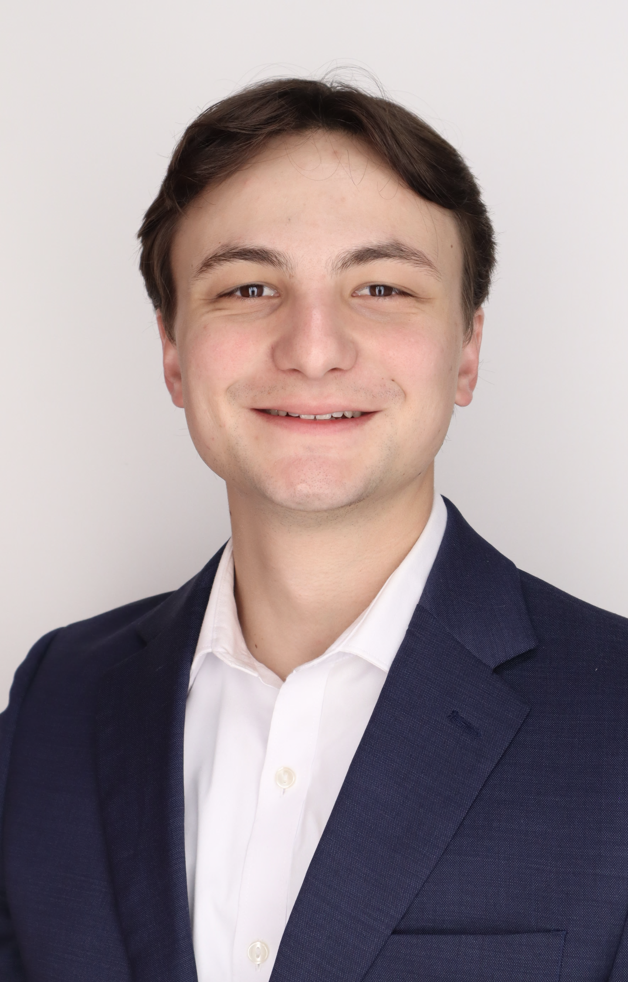
Meet the Team
Grant Hoffmeyer
Grant Hoffmeyer
Systems & Test Engineer
Onyx Oh
Project Engineer
Mason Walters
Design Engineer
Jack Vranicar
Software Engineer

Slide 3

Objective
Grant Hoffmeyer
The objective of this project is to develop curriculum for Mechanical Engineering students at the FAMU-FSU College of Engineering to address the current lack of Programmable Logic Controller (PLC) training.

Slide 4
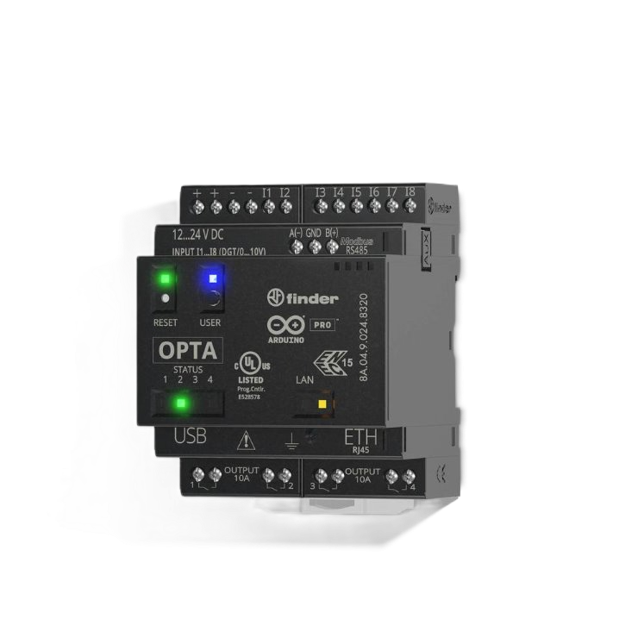
PLCs Explained
Grant Hoffmeyer
Invented in 1968
Used for Automation
Harsh Environments
Ladder Logic
Arduino OPTA RS485

Slide 5
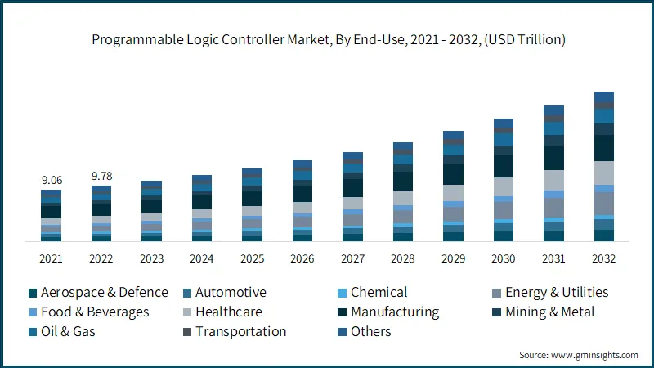
PLC Opportunities
Grant Hoffmeyer

Slide 6



Key Goals
Grant Hoffmeyer
Create and produce 3 labs involving PLCs
Provide student performance milestones
Emphasize the importance of PLCs in the industry

Slide 7
Lab Ideas
Grant Hoffmeyer
Simulation
Sorting System
Human vs. PLC
Ladder logic in MATLAB Simulink
Button to control LED on/off
Conveyor belt to sort different boxes
Fully automated with buttons
Linear actuator push boxes off
Timed game student vs PLC

Slide 8



User-Friendly Simulation
Jack Vranicar
SRC
edit_simulink_plc.m
run_simulink_plc.m
Notes:
Add in some arrows here to show the relationship

Slide 9
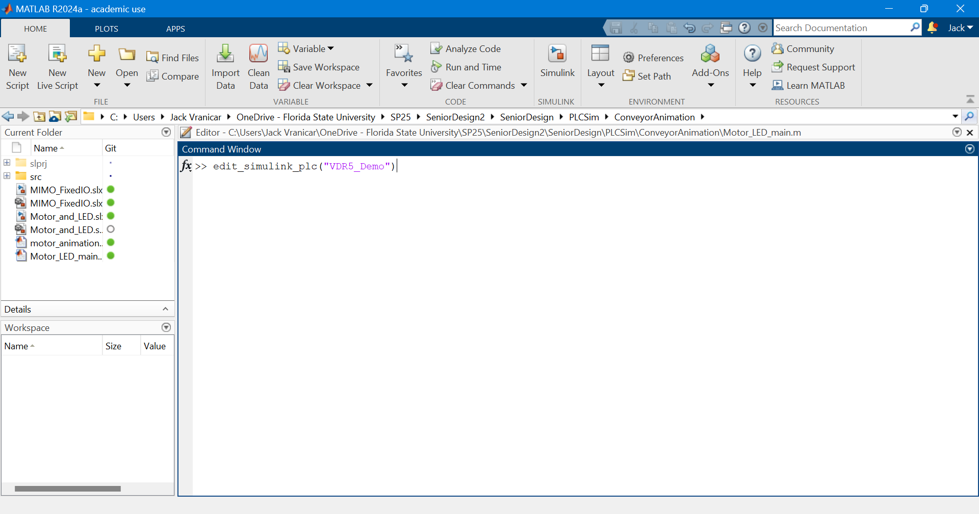
Function call
Jack Vranicar

Slide 10

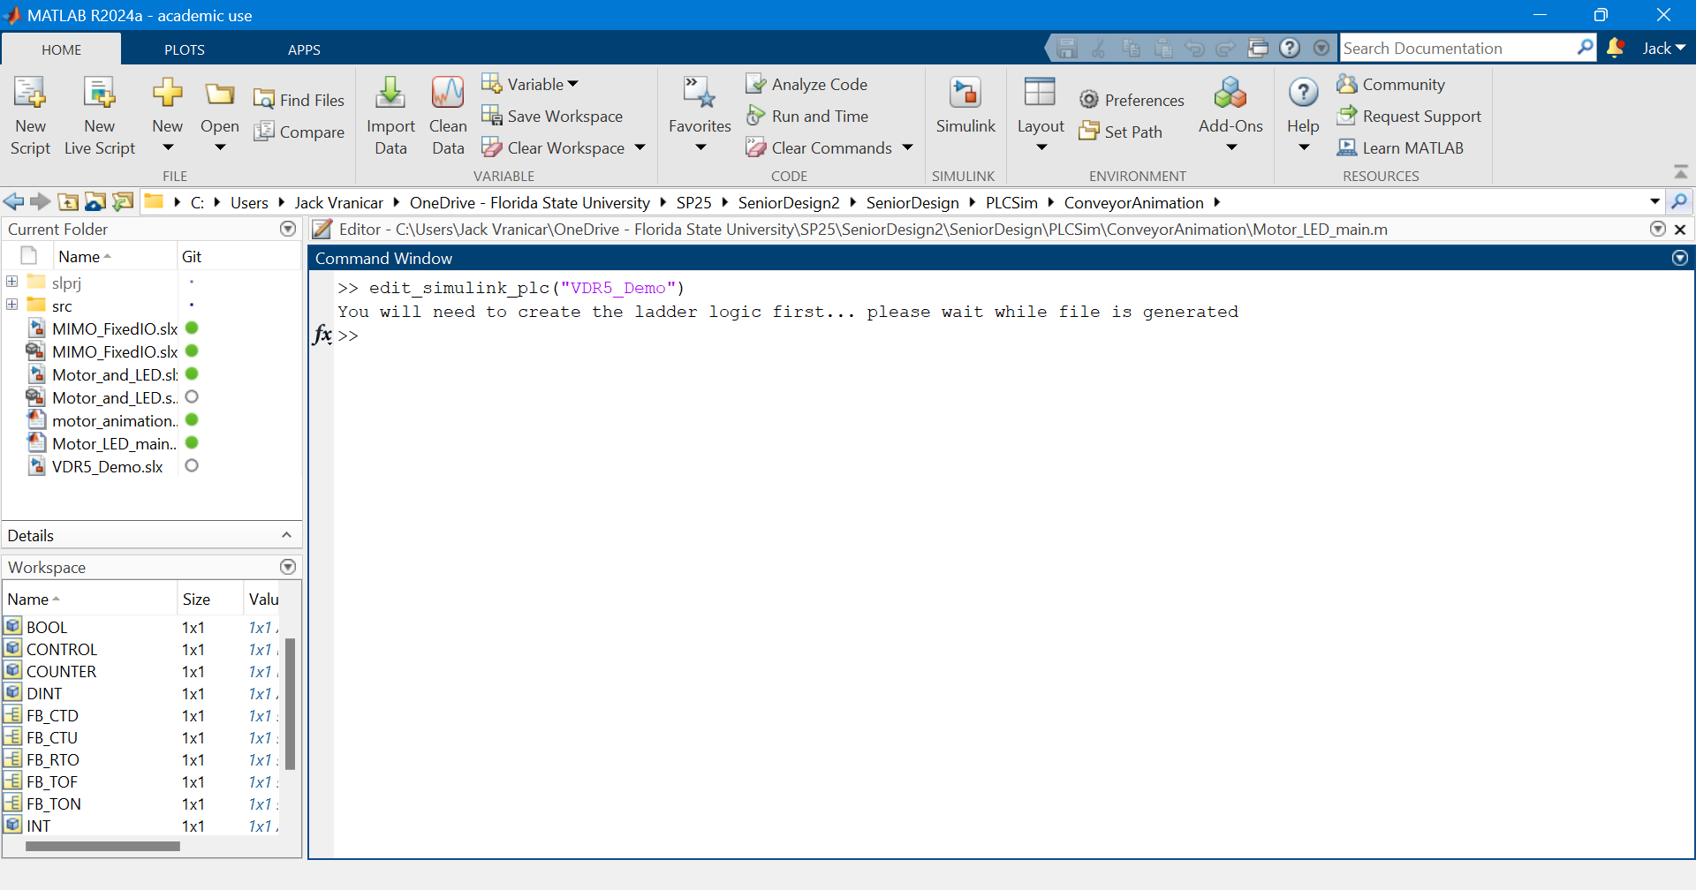
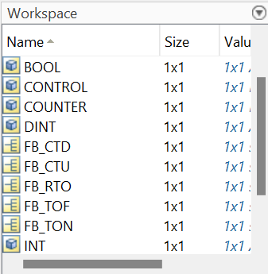
Workspace Generation
Jack Vranicar
Notes:
Add boxes of what was added in; types, automatically saved, display

Slide 11
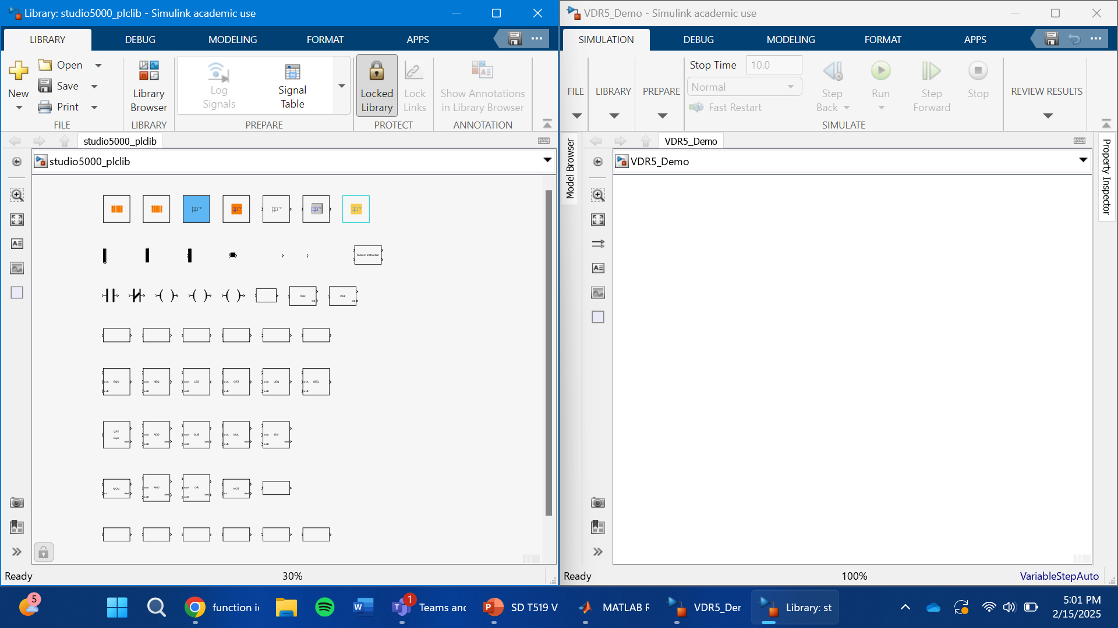

PLC Library and Simulink Opened
Jack Vranicar
Notes:
Show that automatically named

Slide 12
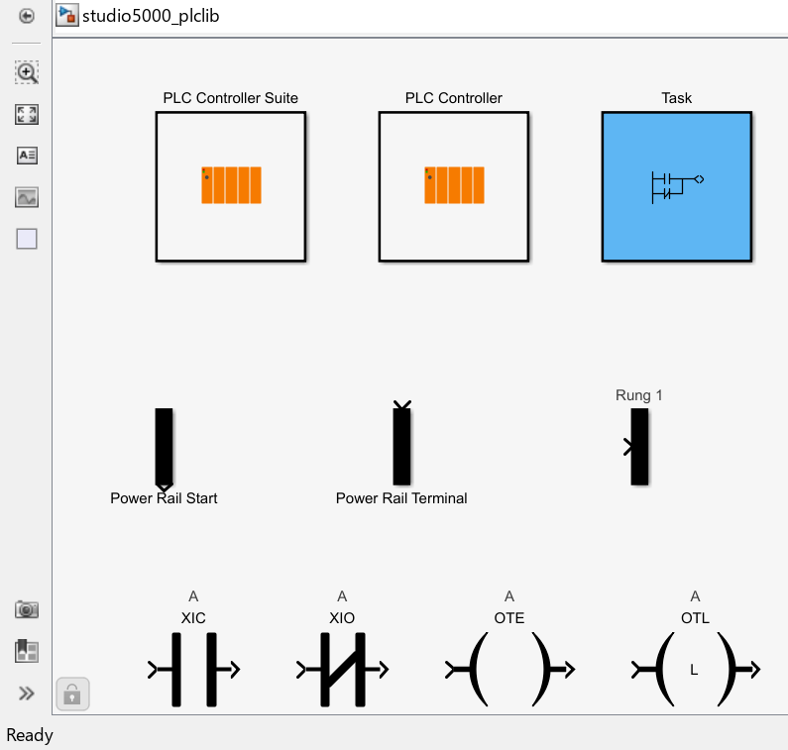
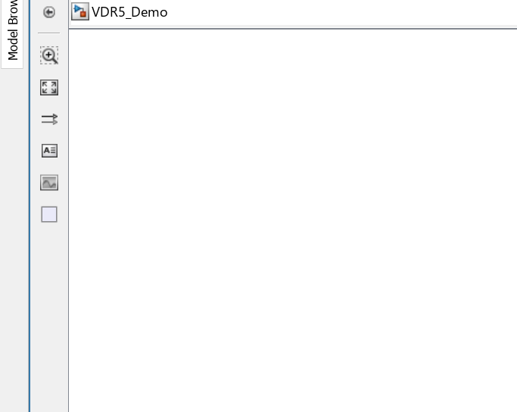
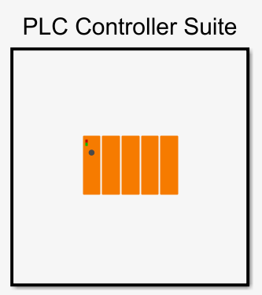
PLC Library and Simulink Opened
Jack Vranicar
Notes:
Make animation of the thing being dragged over

Slide 13
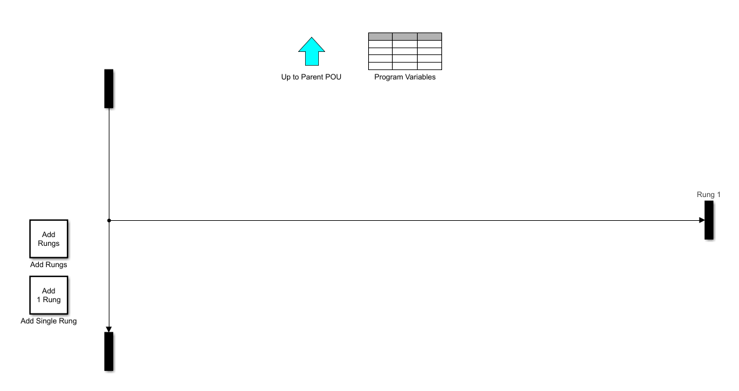
Editing Ladder Logic
Jack Vranicar
Notes:
Make animation of the thing being dragged over

Slide 14
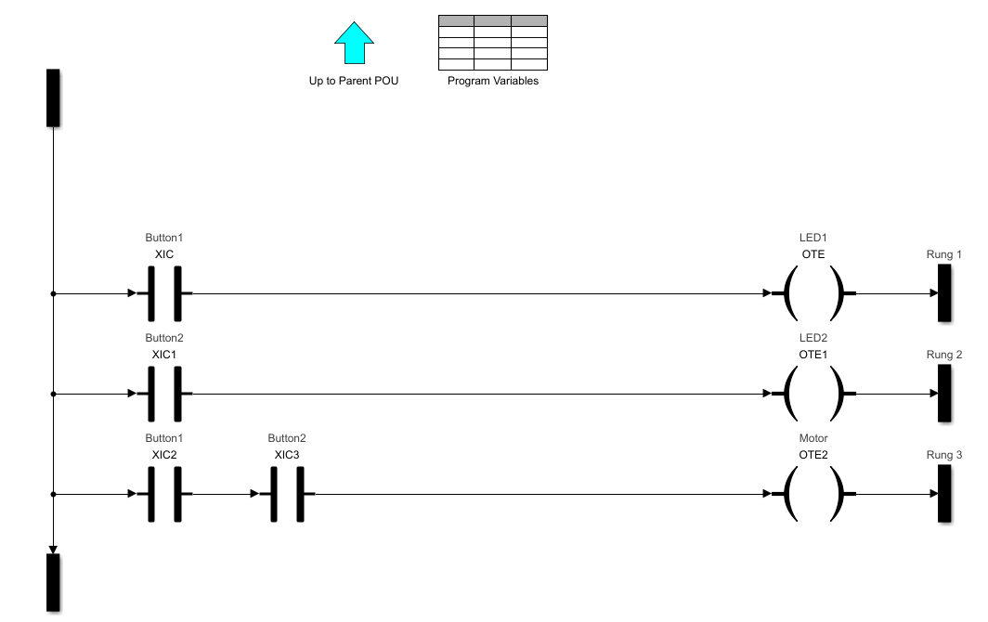
Motor and LED Ladder
Jack Vranicar
+V
GND
if(Button_1 == 1){LED1 = On}
if(Button_2 == 1){LED2 = On}
if(Button_1 == 1 && Button_2 ==1){
Motor = On }

Slide 15
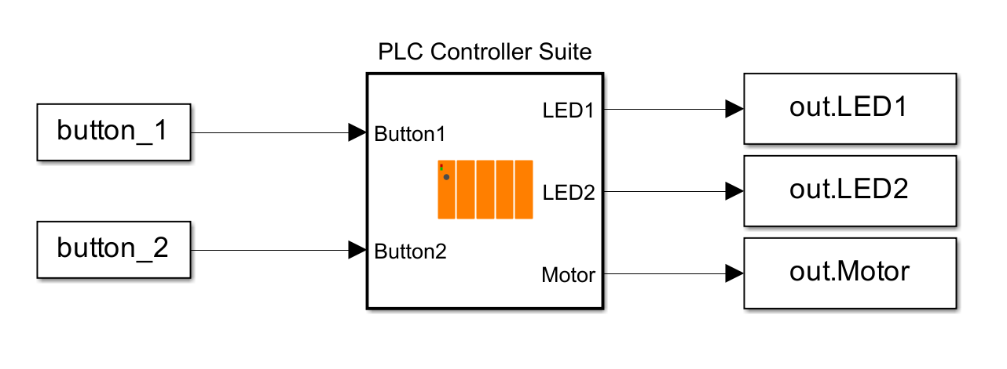
Connecting PLC to Workspace
Jack Vranicar
Notes:
Make animation of the thing being dragged over

Slide 16
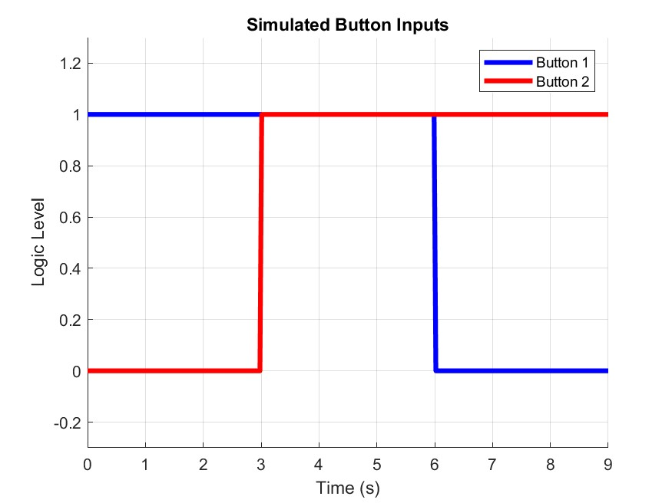
Simulating Button Inputs
Jack Vranicar
Expected Behavior:
When each button is pressed, its corresponding LED turns on.
Only when both buttons are pressed does the motor spin

Slide 17
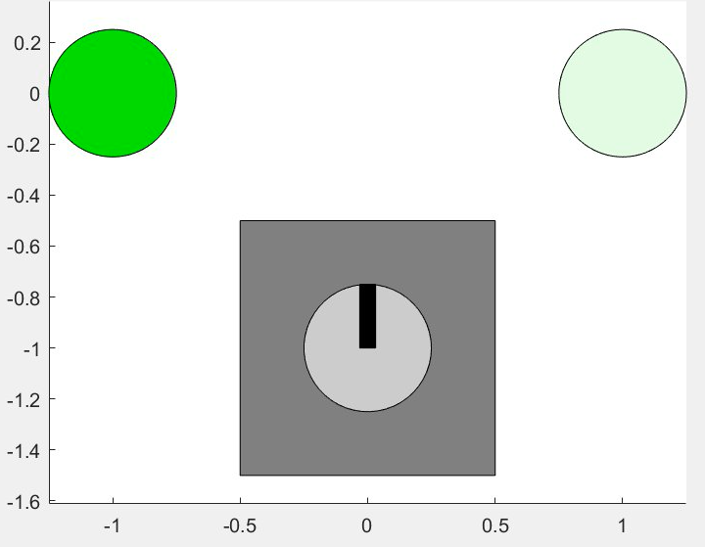
Simulation Results
Jack Vranicar

Slide 18
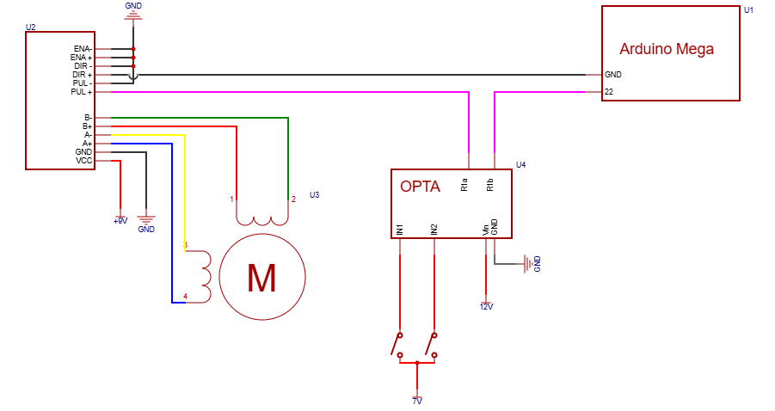
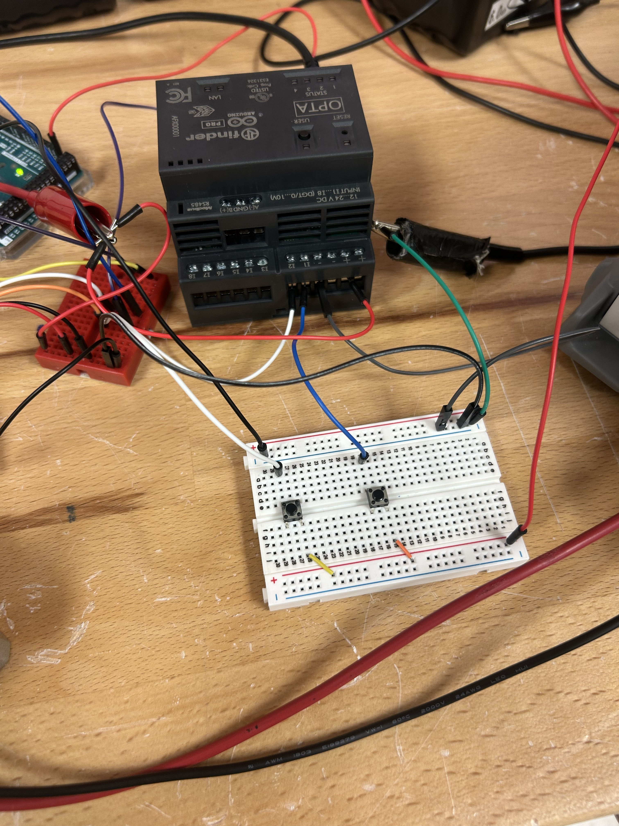
Experimental Design
Jack Vranicar

Slide 19
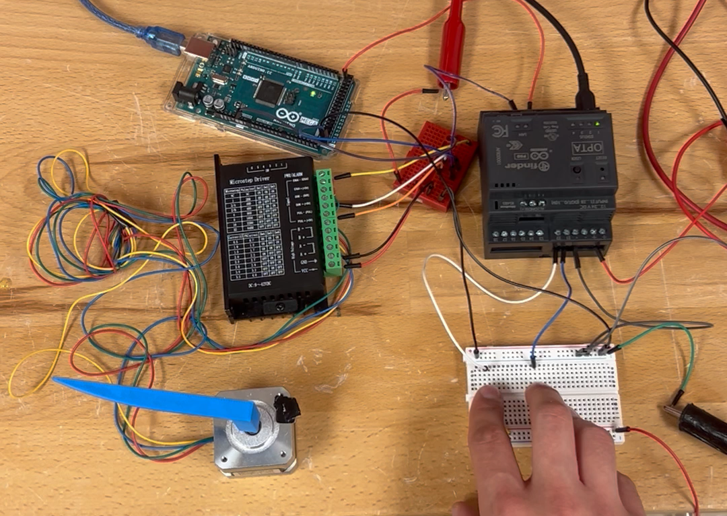
Simulation Verified
Jack Vranicar

Slide 20
Simulation Advantages
Jack Vranicar
Ladder Logic is the same
Convenient visual debugging tool which animates ‘current’
Memory addressing is the same between simulation and PLC IDE
Able to make mistakes without damaging hardware
Heightened student understanding and application of PLCs

Slide 21
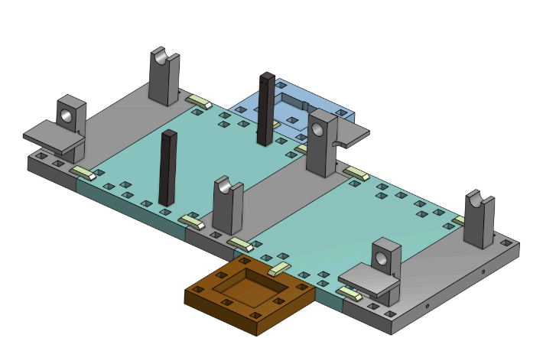
Lab Design
Grant Hoffmeyer

Slide 22
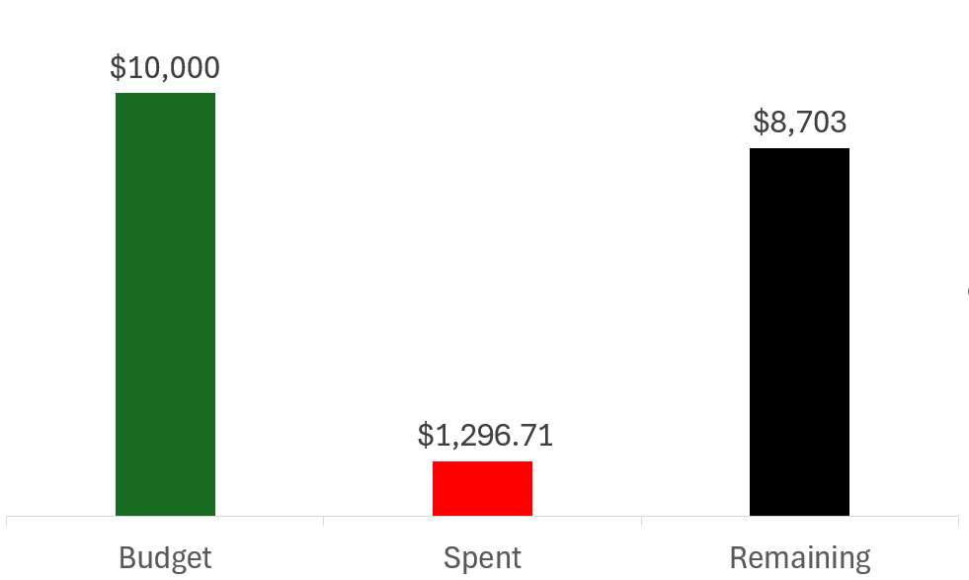
Budget (Development)
Grant Hoffmeyer

Slide 23
Procurement Projection
Grant Hoffmeyer
Item # | Item Description | Cost | Qty
1 | DC Motor | $2.95 | 20
2 | Stepper Motor | $15.94 | 20
3 | Break Beam Sensor | $3.59 | 20
4 | Hardware (Wires, breadboards, electronics) | $15.00 | 20
5 | Arduino OPTA PLC | $159.95 | 20
6 | Arduino Expansion Module | $139.80 | 20
7 | Linear Servo Actuator | $209.00 | 10
9 | Prusa CORE One 3d Printer | $1,199.00 | 2
10 | 10-Drawer Workbench | $798.00 | 1
≈ $12,030.6
Notes:
Hardware will be dictated on what Dr. Ordonez specifically wants to use, but some examples could be male to male connectors, male to female connectors, breadboards, etc.

Slide 24
Future Work
Grant Hoffmeyer
Program and test labs
Creating perfromance milestones and manuals
Organize Mechatronics lab to include PLC lab material
Finalize procurement BoM

Slide 25
Thank you!
Grant Hoffmeyer
Team 519: PLC Controls Lab

Slide 26
References
Grant Hoffmeyer
https://www.famu.edu/academics/colleges-and-schools/engineering/index.php
https://store-usa.arduino.cc/products/opta-rs485
https://store-usa.arduino.cc/products/opta-ext-d1608e
https://www.programmingelectronics.com/arduino-ides/
https://www.rockwellautomation.com/en-us/products/hardware/allen-bradley/programmable-controllers/micro-controllers/micrologix-family/micrologix-1100-controllers.html
https://www.onshape.com/en/
https://www.gminsights.com/industry-analysis/programmable-logic-controller-market

Slide 27








Overview
Onyx Oh
Key Goals
Emphasize the importance of PLCs in the industry
Create and produce 3 labs involving PLCs
Provide student performance milestones

Slide 28
Overview
Onyx Oh
Critical Targets
PLC Learning System
Control
Plant
Facilitate
Control I/O
Move motors
Manage data
Supply power
Integrate logic
Interpret visual feedback
Guide students
Guide faculty

Slide 29




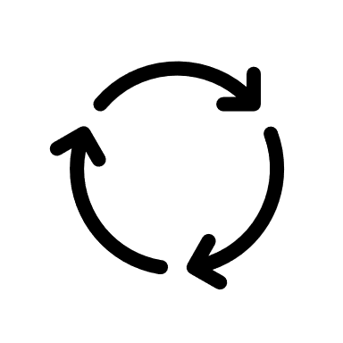
Concept Selection
Onyx Oh
Break beam Sensor
Stepper arm
Conveyer Belt

Slide 30
Onyx Oh
Break beam Sensor
Stepper arm
Conveyer Belt

Slide 31

Concept Selection
Onyx Oh
Notes:
This design is simple yet effective with real world applications. Conveyer belts are commonly used with PLCs as they are used in grocery stores and large manufacturing facilities.

Slide 32
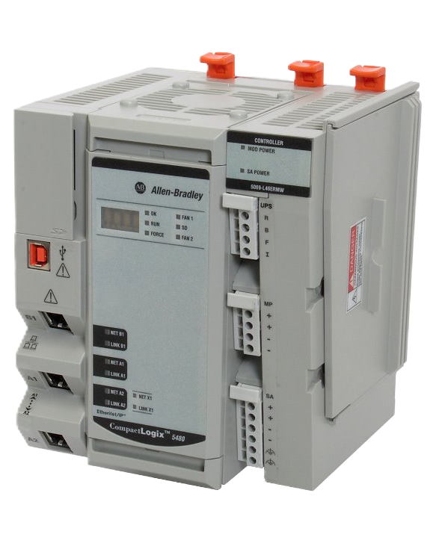
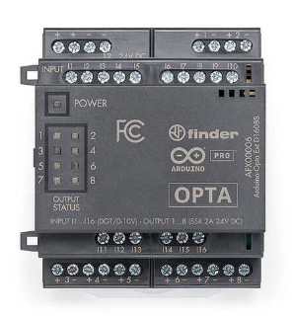

Programmable Logic Controller
Onyx Oh
Expansion module
Arduino PLC IDE
8 outputs
4 outputs
Arduino OPTA RS485
Allen Bradley CompactLogix
Notes:
Chose the Arduino to make the transition easier for students as well as being able to purchase a multitude of them for each lab group to have their own… (any more reasons I can add?)
What is the Arduino application/software we use now in the labs?

Slide 33
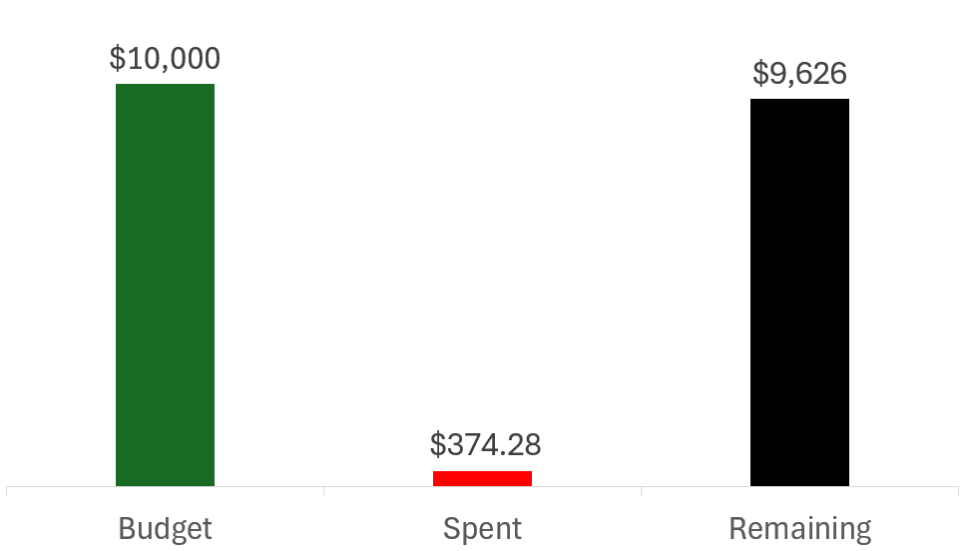
Budget
Onyx Oh
Notes:
$10,000 for project
$12,000 for supplying the classroom

Slide 34
Cost Per Lab Set Up
Onyx Oh
Item # | Item Description | Cost
1 | DC Motor | $2.95
2 | Stepper Motor | $15.94
3 | Break Beam Sensor | $3.59
4 | Hardware (Wires, breadboards, electronics) | $30.00
5 | Arduino OPTA PLC | $159.95
6 | Arduino Expansion Module | $139.80
≈ $352.23
Notes:
Hardware will be dictated on what Dr. Ordonez specifically wants to use, but some examples could be male to male connectors, male to female connectors, breadboards, etc.

Slide 35




Scope Increase
Mason Walters
All parts will be made by 3D printer
Purchasing materials for a full class size plus ½
Lab station remodeled for PLC lab components
35

Slide 36

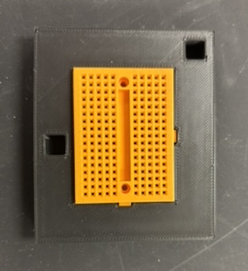
Old vs. New Design
Mason Walters

Slide 37
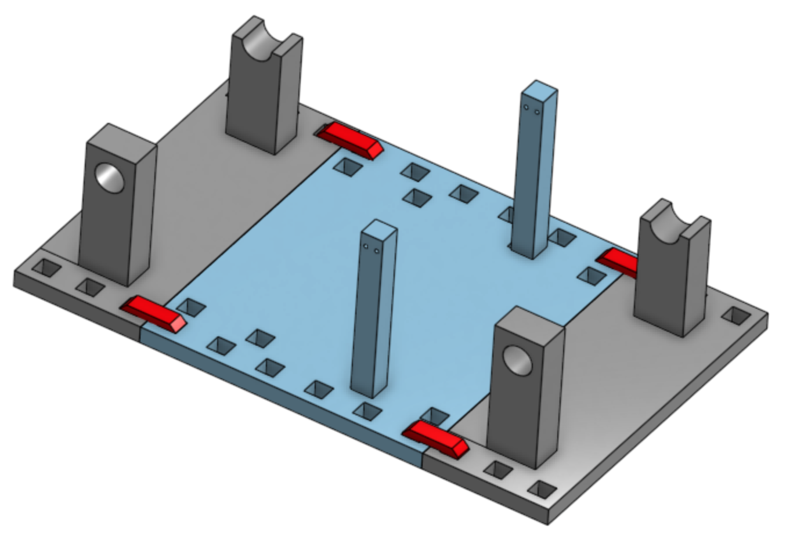
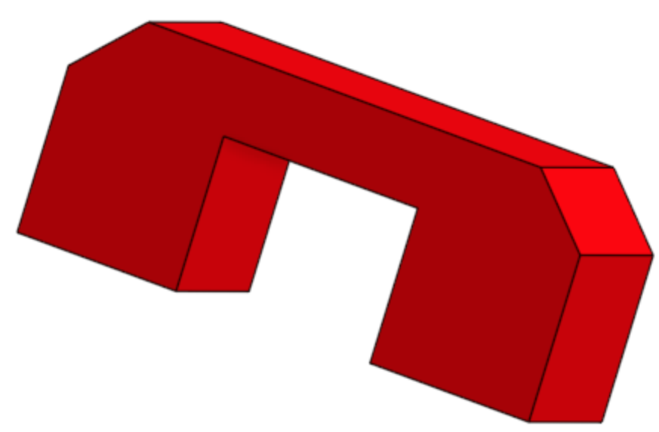
Design Improvements
Mason Walters

Slide 38
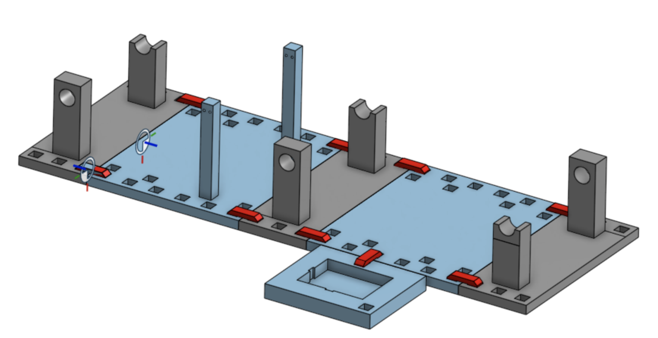
Design Improvements
Mason Walters
Versatile design
Increased combinations of hardware
Helps labs build on from the previous
Allows students for customize for their own Mechatronics project

Slide 39
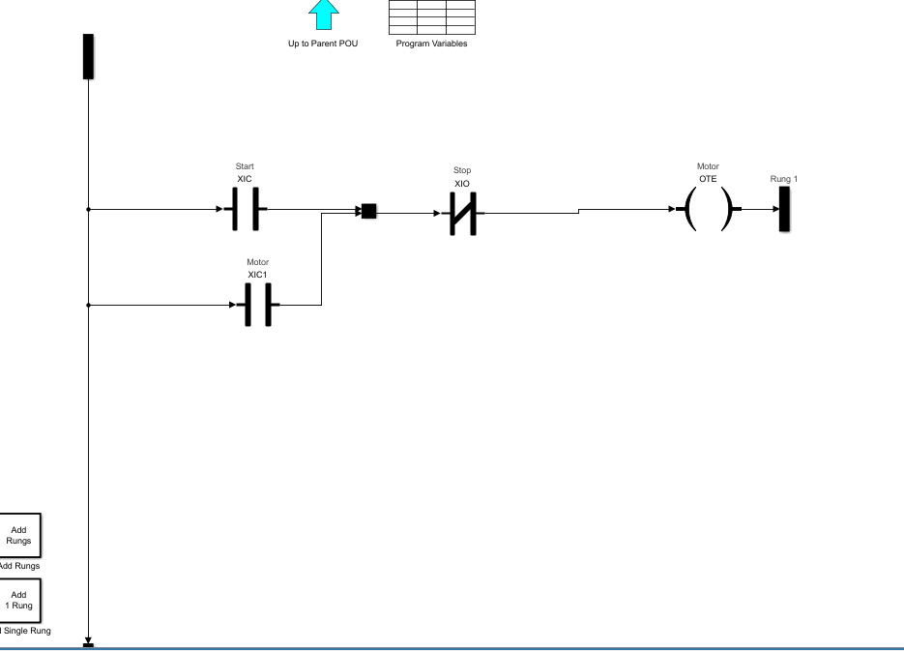
Ladder Logic Simulation
Notes:
Just explain briefly that we have been messing with a ladder logic simulation done with the simulink toolbox on MATLAB
Explain what each symbol means briefly and what this ladder logic diagram is doing

Slide 40
Future Work
Mason Walters
Print and assemble new prototype
Collaborating with sponsor to create lab documentation
Remodel Mechatronics lab to include PLC lab material
Order parts (About 42 Units)

Slide 41
Thank you!
Mason Walters
Team 519: PLC Controls Lab

Slide 42
References
Mason Walters
https://www.famu.edu/academics/colleges-and-schools/engineering/index.php
https://store-usa.arduino.cc/products/opta-rs485
https://store-usa.arduino.cc/products/opta-ext-d1608e
https://www.programmingelectronics.com/arduino-ides/
https://www.rockwellautomation.com/en-us/products/hardware/allen-bradley/programmable-controllers/micro-controllers/micrologix-family/micrologix-1100-controllers.html
https://www.onshape.com/en/

Slide 43
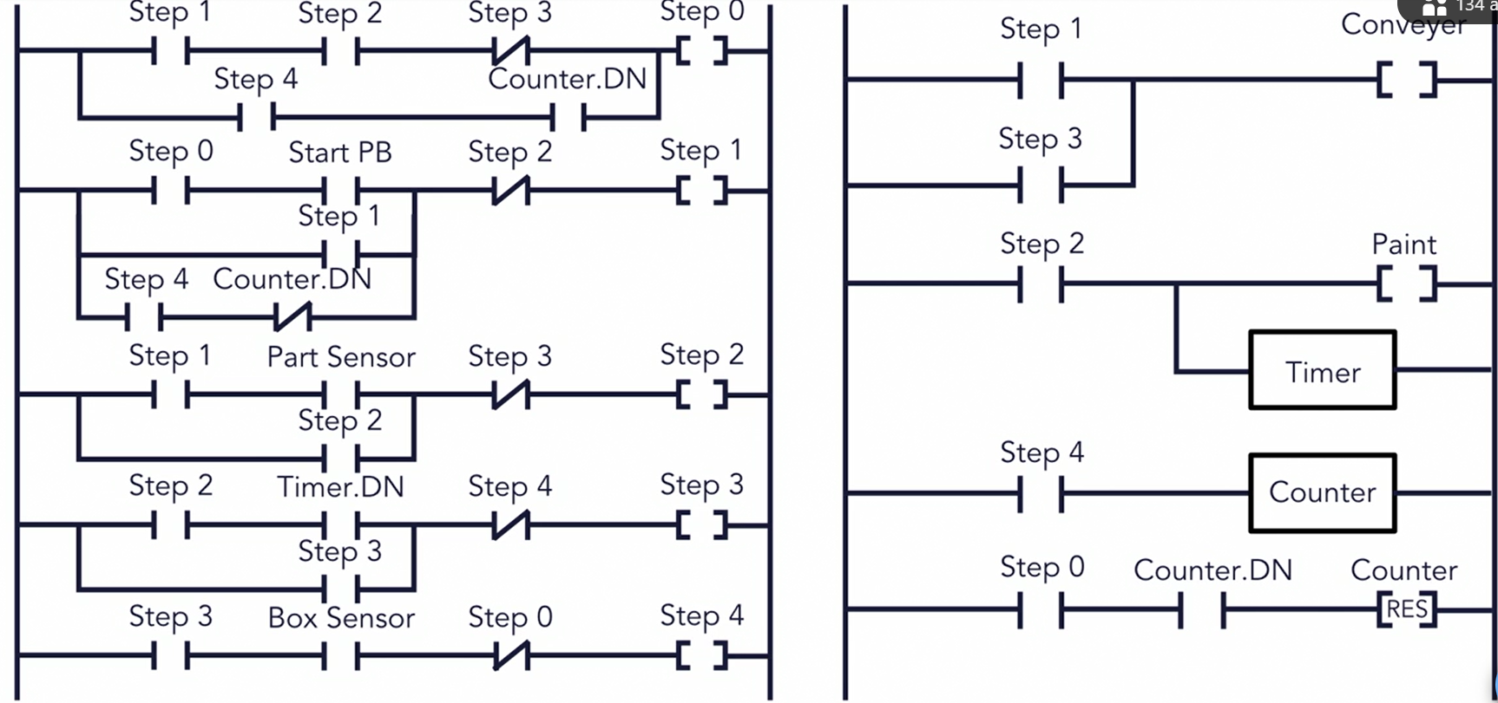
Ladder Logic Example
Jack Vranicar

Slide 44



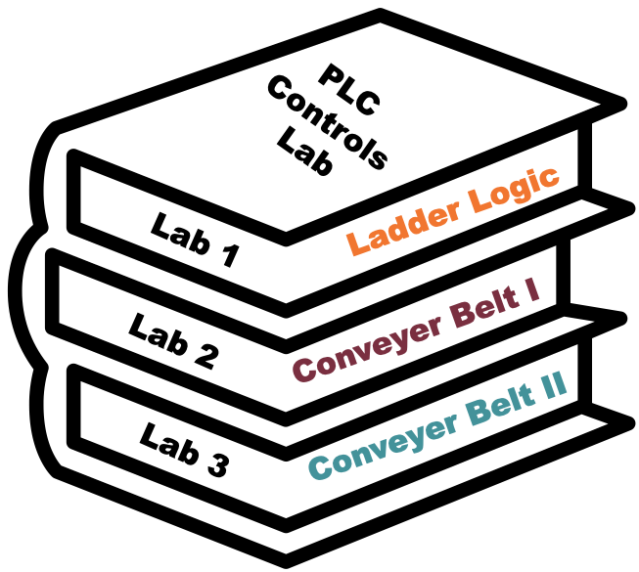
Curriculum Design
Mason Walters
Lab 1: Ladder Logic
Lab 2: Conveyer
Belt I
Lab 3: Conveyer
Belt II
Pre-lab activity: Online Ladder Logic
Lab: Control light via button/switch and activate relay using ladder logic
Pre-lab activity: 3D Print necessary parts
Lab: Run conveyer belt via DC motor
Pre-lab activity: 3D Print necessary parts
Lab: Add sensors and motor to system

Slide 45
PLC Controls Lab
Team 519
Grant Hoffmeyer & Jack Vranicar
Virtual Design Review #2, November 12, 2024

Slide 46
Meet the Team
Onyx Oh
Grant Hoffmeyer
Systems Engineer
Onyx Oh
Test Engineer
Mason Walters
Design Engineer
Jack Vranicar
Software Engineer

Slide 47
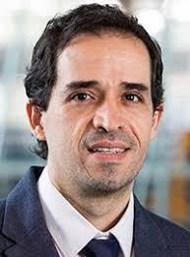
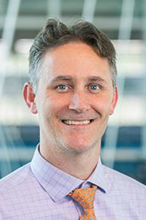

Sponsor and Advisor
Onyx Oh
Industry Collaborator
Rockwell Automation
Sponsor
Dr. Camilo Ordoñez
Academic Advisor
Dr. Shayne McConomy

Slide 48
Objective
Onyx Oh
The objective of this project is to develop curriculum for Mechanical Engineering students at the FAMU-FSU College of Engineering to address the current lack of Programmable Logic Controller (PLC) training.
https://meetings.informs.org/wordpress/phoenix2023/exhibit-hall/famu-fsu-college-of-engineering-industrial-manufacturing/

Slide 49

What is a PLC?
Onyx Oh
Programmable Logic Controllers (PLCs) are computers that are widely used to control industrial equipment. They facilitate manufacturing and production lines by analyzing inputs and controlling outputs.
https://www.solutiontree.com/blog/enhancing-plc-process/

Slide 50
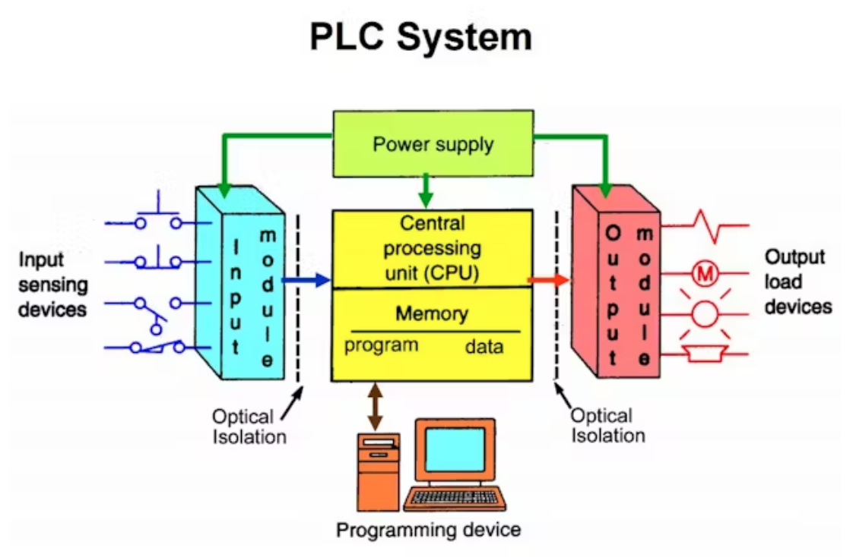
Why PLCs?
Onyx Oh
Reduce costs
Saves time
Minimal manual labor
~$11.6 billion market value
https://www.amazon.com/EJWFASCV-BMEH586040-Redundant-Industrial-Environments/dp/B0D982QLGM
Notes:
PLCs reduce costs, saves time, and yields little to no manual labor. The current market value of PLCs is roughly $11.6 billion and is expected to continue to grow by 4.7% in the next eight years

Slide 51
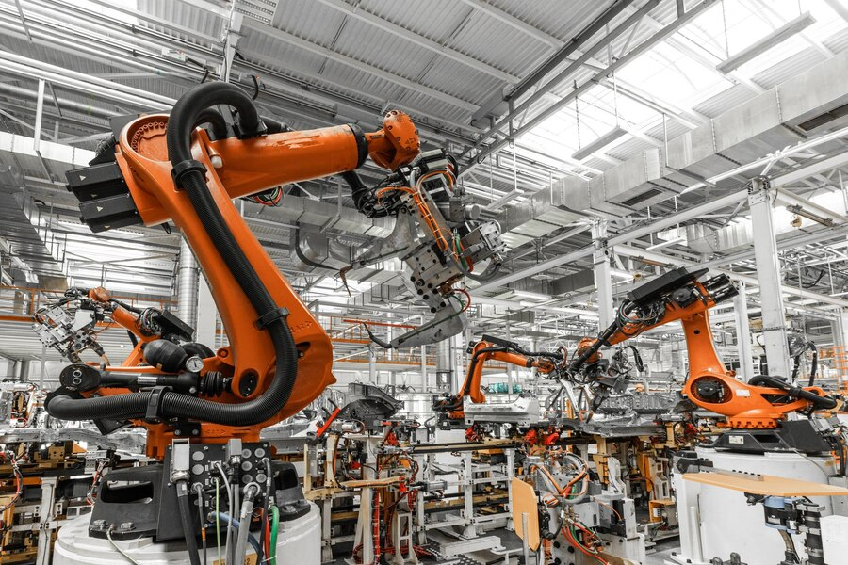
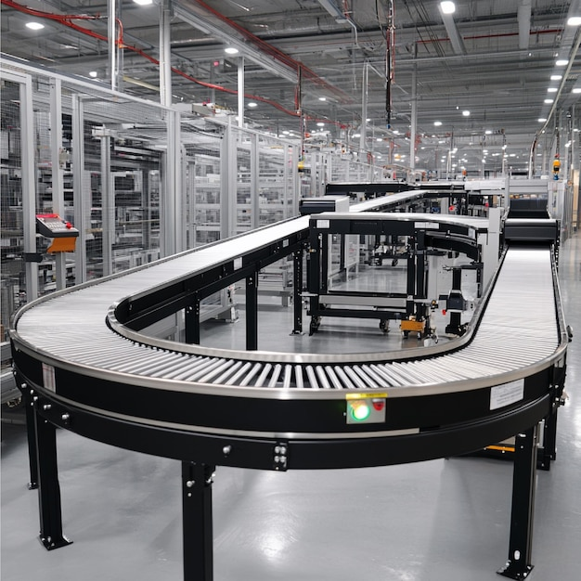
Applications of PLCs
Onyx Oh
https://www.freepik.com/free-photo/photo-automobile-production-line-welding-car-body-modern-car-assembly-plant-auto-industry_26150191.htm#fromView=search&page=1&position=6&uuid=fd68e528-1825-48bf-a991-c38e381b081b
https://www.freepik.com/premium-ai-image/automated-conveyor-systems-moving-products-different-stages-production-process_298771504.htm#fromView=search&page=1&position=13&uuid=122b5ab9-a6d8-4dd6-9324-f5d8c1f74f42

Slide 52




Key Goals
Onyx Oh

Slide 53



Key Goals
Onyx Oh
Design and produce three labs that introduce the fundamentals of PLCs, programming methods, and troubleshooting techniques
Create curriculum that emphasizes the importance and opportunities associated with PLCs, as they are widely used in many different industries
Ensure students can apply logic principles to various PLC models and applications
Create performance milestones through implementing post lab-assessments and surveys

Slide 54












Assumptions
Onyx Oh
Access to shop facilities, tools, materials, university
personnel, & communication
PLC equipment and hardware will be provided by the university
Students will have a basic understanding of Mechatronics concepts from the course and pre-requisites
The professor and teaching assistants will be competent to supervise labs and teach the material

Slide 55














Assumptions
Onyx Oh
Labs will take place in the Mechatronics Lab at the College of Engineering (Room B356)
Legal and safety protocols will be implemented in the lab
The classroom will obtain electrical safety equipment prior to labs utilizing PLCs
Liquids or food will be prohibited in the lab

Slide 56


Primary Markets
Mason Walters
Dr. Camillo Ordonez,
Mechatronics 1 Professor
Mechatronics 1 Students

Slide 57


Secondary Markets
Mason Walters
Outside Universities
PLC Manufacturers

Slide 58
Stakeholders
Mason Walters
 | Investors | Decision Makers | Advisors | Receivers
Sponsors | Dr. McConomy Dr. Ordonez | Dr. Ordonez | Dr. McConomy Dr. Ordonez | Dr. McConomy Dr. Ordonez
Managers | Dr. McConomy Dr. Ordonez | Dr. McConomy Dr. Ordonez | Dr. McConomy Dr. Ordonez | Dr. McConomy Dr. Ordonez
Experts | Rockwell Auto. | Rockwell Auto. | Dr. McConomy Dr. Ordonez | Rockwell Auto.
Operators | N/A | Dr. Ordonez | Dr. Ordonez Rockwell Auto. | Dr. Ordonez Students, TA's Rockwell Auto.
General Readers | N/A | Dr. Ordonez | Dr. McConomy Dr. Ordonez | Dr. McConomy Dr. Ordonez Students, TA's General Public

Slide 59
Stakeholders
Mason Walters
 | Investors | Decision Makers | Advisors | Receivers
Sponsors | Dr. McConomy Dr. Ordonez | Dr. Ordonez | Dr. McConomy Dr. Ordonez | Dr. McConomy Dr. Ordonez
Managers | Dr. McConomy Dr. Ordonez | Dr. McConomy Dr. Ordonez | Dr. McConomy Dr. Ordonez | Dr. McConomy Dr. Ordonez
Experts | Rockwell Auto. | Rockwell Auto. | Dr. McConomy Dr. Ordonez | Rockwell Auto.
Operators | N/A | Dr. Ordonez | Dr. Ordonez Rockwell Auto. | Dr. Ordonez Students, TA's Rockwell Auto.
General Readers | N/A | Dr. Ordonez | Dr. McConomy Dr. Ordonez | Dr. McConomy Dr. Ordonez Students, TA's General Public

Slide 60
Customer Needs
Mason Walters
Customer Need #1
The curriculum should prepare students to broaden their skill sets for future employment opportunities
Customer Need #3
Focus on software and hardware troubleshooting with a focus in ladder logic
Customer Need #2
The curriculum should match the content covered at other universities and preliminary training
Beneficial concepts added to the labs would include the creation of communication networks, human machine interfaces (HMIs), and structured text
Customer Need #4
Notes:
Customer need #1: Content should provide students with introductory understanding (Q1), prior experience simulating an automated system will allow students to succeed as a new employee (Q8)
Customer need #2: Content matches the quality that is produced at other universities (Q2), content should match concepts covered in Rockwell’s training toolkit to reduce the learning curve for new employees (Q4), curriculum will support Rockwell’s training material (Q10)
Customer need #3: ladder logic is crucial for Rockwell’s training (Q3), students will be best prepared with conditions that match the industry, which includes software and hardware troubleshooting (Q6)
Customer need #4: communication networks is an advanced skill (Q7), HMI development is an advanced skill (Q9)

Slide 61
Functional Decomposition
Mason Walters
PLC Learning System
Control
Facilitate
Plant

Slide 62
Functional Decomposition
Mason Walters
Control
Integrate logic
Interpret visual feedback

Slide 63
Functional Decomposition
Mason Walters
Plant
Control inputs and outputs
Move motors
Supply power
Receive input signal
Deliver output signal
Manage data
Record data
Communicate Data
Limit maximum voltage
Limit maximum current
Disconnect power

Slide 64
Functional Decomposition
Mason Walters
Facilitate
Guide students
Guide faculty
Transfer instructions
Provide safety protocols
Transfer critical knowledge
Provide performance measures

Slide 65
Looking Forward
Mason Walters
Receive material/training from Rockwell
Coordinate with Center of the Advancement of Teaching
Familiarize ourselves with FSU and Rockwell licensing and vending processes
Continue learning and programming PLCs using Ladder Logic

Slide 66
Hardware

Slide 67
Back Up Slides

Slide 68





Slide Headline
Try to keep text at 16 pt minimum.
Try to put as few words as possible on the slide if you’re using for a presentation.
Mix and match the backgrounds as shown in this template or just use one throughout.
You can put department/unit logos in slide master at Horizontal 0.89” Vertical 6.44” From top left corner

Slide 69
Font Check
This is 10-point
This is 15–point Times
This is 20–point
This is 25–point
This is 30–point
This is 35–point
This is 40–point
This is 50–point
This is 60–point
This is 72–point
Notes:
Use at least 20-point font in Room A105, B134, and B136
Use at least 25-point font in Room B135

Slide 70
College of Engineering Color Palette
1 2 3 4
Pantone: PMS 195 C
RGB: 120, 47, 64
Hex: #782F40
CMYK:19, 90, 50, 55
1 2 3 4
Pantone: Black C
RGB: 0, 0, 0
Hex: #000000
CMYK:0, 0, 0, 100
Garnet
Black
1 2 3 4
RGB: 238, 118, 36
Hex: #EE7624
CMYK:2, 66, 99, 0
1 2 3 4
Pantone: PMS 000C
RGB: 255, 255, 255
Hex: #FFFFFF
CMYK: 0, 0, 0, 0
Fang
Orange
White
Notes:
Avoid 75% Black in B135

Slide 71
Accent Color Palette
1 2 3 4
RGB: 0, 59, 111
Hex: #003B6F
CMYK:
1 2 3 4
RGB: 0, 59, 111
Hex: #003B6F
CMYK:
1 2 3 4
RGB: 251, 236, 93
Hex: #FBEC5D
CMYK:
1 2 3 4
RGB: 219, 215, 210
Hex: #DBD7D2
CMYK:
1 2 3 4
RGB: 251, 236, 93
Hex: #FBEC5D
CMYK:
1 2 3 4
RGB: 219, 215, 210
Hex: #DBD7D2
CMYK:
Tardis Blue
Tardis Blue
Corn
Timberwolf
Corn
Timberwolf
1 2 3 4
RGB: 206, 0, 88
Hex: #CE0058
CMYK: 0, 100, 43, 12
1 2 3 4
RGB: 206, 0, 88
Hex: #CE0058
CMYK: 0, 100, 43, 12
1 2 3 4
RGB: 104, 40, 96
Hex: #682860
CMYK:
1 2 3 4
RGB: 220, 220, 220
Hex: #DCDCDC
CMYK:
Rubine Red
Rubine Red
Imperial
Gainsboro
1 2 3 4
RGB: 72, 146, 155
Hex: #48929b
CMYK:
1 2 3 4
RGB: 64, 224, 208
Hex: #40E0D0
CMYK:
1 2 3 4
RGB: 255, 139, 0
Hex: #FF8B00
CMYK:
Asagi-iro
Turquoise
American Orange
Notes:
Remove American orange add hyperlink grey
Make corn the last for b135
All work in 134 imperial move later
Tardis doesn’t work in b136

Slide 72
F7AB19
D67F15
EE7624
D64615
F73119
Analogous
6E3610
F0A16C
EE7624
6E4931
BASB1C
Monochromatic
A14508
4BED3B
EE7624
250CED
2010A1
Triad
A1470C
FF8C40
EE7624
0098A1
24E2ED
Complementary
28A164
2FED8D
EE7624
0848A1
1871ED
Split Complementary
EDAC2F
3BED93
EE7624
0C6AED
ED2F18
Double Split Complementary
ED660C
C7ED3B
EE7624
0CE1ED
A418ED
Square
BA7E09
87724A
EE7624
60EFCF
09BA61
Compound
https://color.adobe.com/create/color-wheel
AD551A
6E3610
EE7624
FA7625
D46820
Shades
Notes:
These are the variants that work well with Fang Orange. The bolded items show well on the projectors.

Slide 73
85412D
8F3831
782f40
8F3176
792D85
Analogous
C44D69
8E626D
782F40
C48796
451B25
Monochromatic
C43959
78743B
782F40
236178
43A2C4
Triad
C43959
C46078
782F40
25C43D
2F783A
Complementary
93C460
577835
782F40
39C49D
297861
Split Complementary
784435
5A783B
782F40
237860
6E2978
Double Split Complementary
782337
78683b
782F40
237830
293978
Square
AB4D32
DEBAAF
782F40
5D8555
70AB32
Compound
https://color.adobe.com/create/color-wheel
38161E
C44D69
782F40
853447
5E2532
Shades

Slide 74
A105
A105
B135 Stage Left
B135 Stage Right
B136
B134, A105
B135

Slide 75
Border Line
Border Line
Border Line
Center of White Space
Center of Slide
Middle of Slide
Middle of White Space
Edge of Branding
Border Line
Notes:
Vertical lines from top down.
Borderline and top of title. (0.5 inch)
Center of Slide (0 inch y-direction for the entire slide)
Center of Design Content (0 inch y-direction considering the title, footer, and negative space)
Bottom of Design Content (0.25 in gap to the footer. 0.75 to the bottom of the screen)
Horizontal lines from left to right
Borderline (0.5 inch)
Center of design content.
Center of slide (0 inch y-direction for the entire slide)
Borderline (0.125 inch all around)

